Slide 1






BCs3143 – chapter 2
Software Project Management
PROJECT PLANNING

Slide 2



1
PROJECT MANAGEMENT METHODOLOGY (PMBOK)
PHASE | ACTIVITIES | DELIVERABLES
INITIATION | Develop Project charter Identify stakeholder | Project charter document
PLANNING | Develop project management plan Define scope Create WBS & Develop schedule Estimate cost & Determine budget Plan resource Communication management Risk Management Procurement Stakeholder Management | Project implementation plan ~ Timeline ~ Cost ~ Resource ~ Risk ~ Procurement
EXECUTION | Execute & manage the plan Acquire project team
CONTROL & MONITORING | 1. Perform change control | Change control Progress Report
CLOSING | Close project – i.e Procurement | Project closure Lesson learnt

Slide 3


4
PROject management plan
APPENDIX 1

Slide 4


3
PROject management plan
APPENDIX 1

Slide 5
4
Determining and Documenting a list of specific project goals, deliverables, tasks, costs and deadline
Explains the boundaries of the project,
Establishes responsibilities for each team member
Sets up procedures for how completed work will be verified and approved.
PROJECT
scope

Slide 6
5
WORK BREAKDOWN STRUCTURE
(wbs)
https://www.workbreakdownstructure.com/Development Team

Slide 7








WORK BREAKDOWN STRUCTURE (WBS)
What ?
"A hierarchical decomposition of the total scope of work to be carried out by the project team to accomplish the project objectives and create the required deliverables.“ – PMBOK 5
Why?
Is used to break down a project into easily manageable
components, or bites.
Benefit of WBS :
Assists with accurate project organization
Helps with assigning responsibilities
Shows the control points and project milestones
Allows for more accurate estimation of cost, risk and time
Helps explain the project scope to stakeholders
NOTES : Thinking in detail is critical when planning your project, but you also need to consider the big picture. If you fail to
identify a major part of your project’s work, you won’t have the chance to detail it. A work breakdown structure is key.

Slide 8
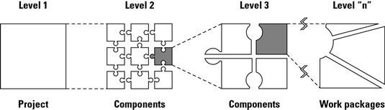
HOW TO CREATE A WBS
The diagram here shows that the entire project as Level 1.
Level 2 – subdivided Level 1 into smaller components
Level 3 – subdivided Level 2 into smaller components
Continue to subdivide all the components until it defined are sufficiently detailed for planning and management purposes. The lowest-level component in a particular WBS branch is called work packages.

Slide 9
EXERCISE 5 : CREATE WBS
SCENARIO
You plan for a 2 day 1 night outing with your friends to Langkawi in Oct 2019.
Come out with your WBS and milestone for the project
(write down each activity on post-it notes & arrange)

Slide 10






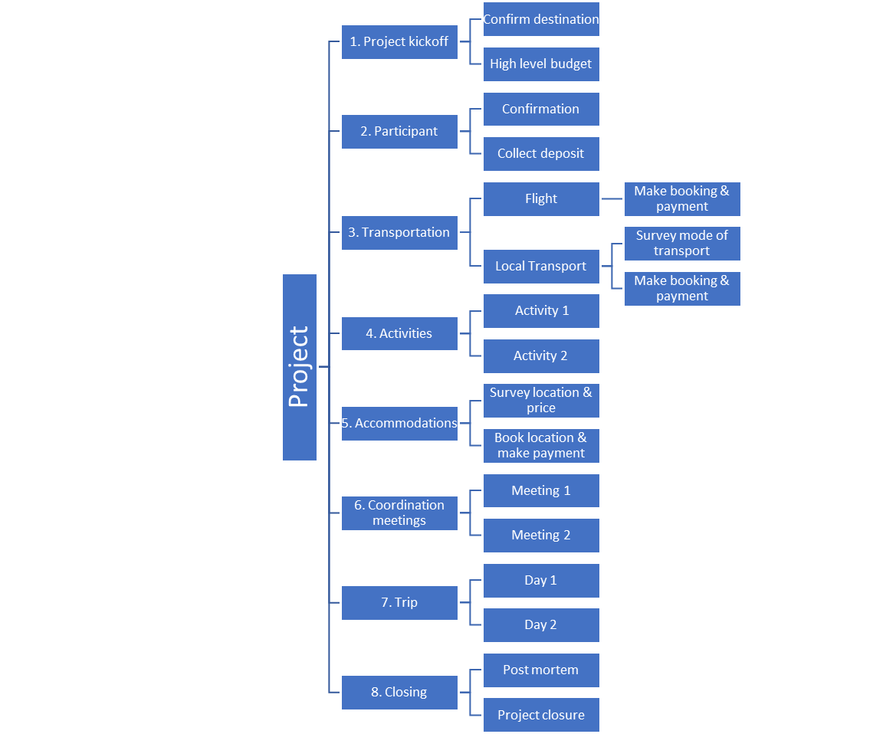




SAMPLE WBS FOR LANGKAWI TRIP
Level 1 Level 2 Level 3 Level 4
B

Slide 11

12
EXERCISE
https://www.youtube.com/watch?v=dPK0afWdm50

